Slide 1
Extract, Transform, & Load.
By: Charles Owusu-Ansah
Ruth Frimpong
Debora Rogers
King D. Nsiah
Amon Thomas

Slide 2
Objective
The goal of this project was to extract information from 4 IMDB datasets and then transform and format the information to meet the specifications listed. After that, we loaded the data into a ERD format to display the relationship and descriptions of each table.

Slide 3
Requirements
An actor table with unique actors and actresses' names that also contains a numerical field for age and a boolean field to identify if the actor or actress is currently alive, deceased, or unknown.
A film table that contains a character field for the original title, a numerical field for the average critic rating, a character field for the type of film and a datetime field that has the runtime of the film in HH:MM format.
A producer table that contains only producer names and links to the film table.
A characters table with unique character names that links the actors and film tables together.

Slide 4
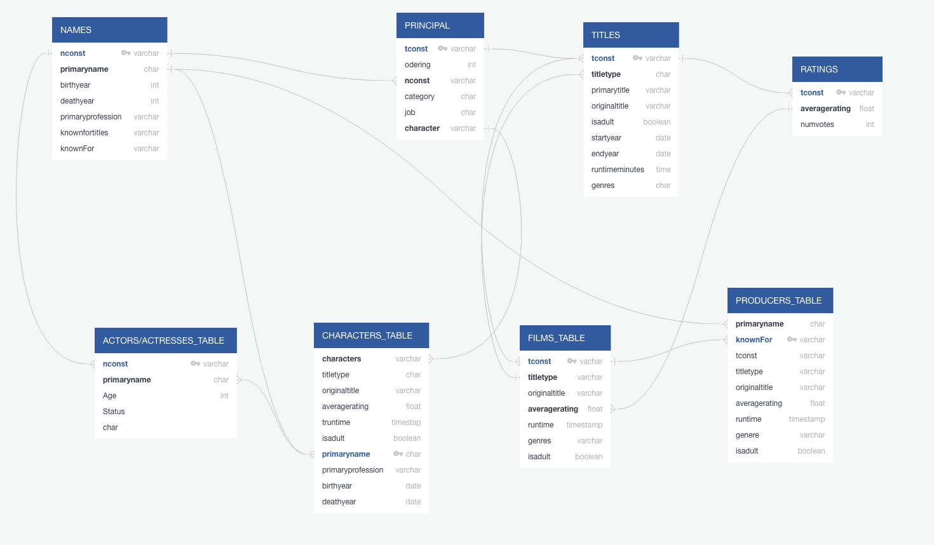
ERD DIAGRAM

Slide 5
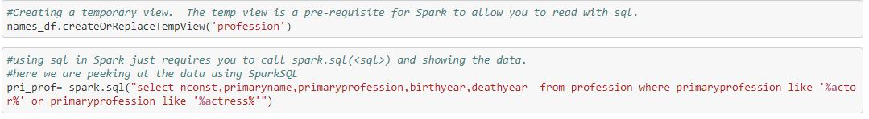
Requirement #1 Extract
Read in “filterNames” file using a S3 bucket
Filtered using sql in Spark to display only individuals who had actor or actress in their primary profession

Slide 6
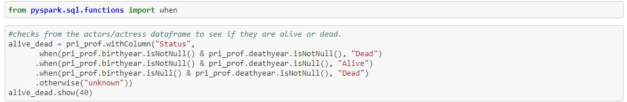
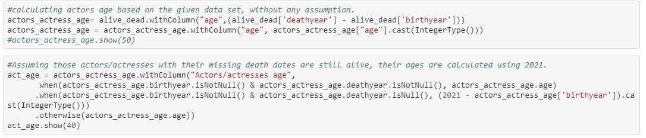
Requirement #1 Transform
Added a column labeled “Status” which determines whether the person is either dead, alive, or unknown based on the the presence of a birth and death year
Calculated the ages of the individuals that we can confirm are either dead or live and added it as a column

Slide 7
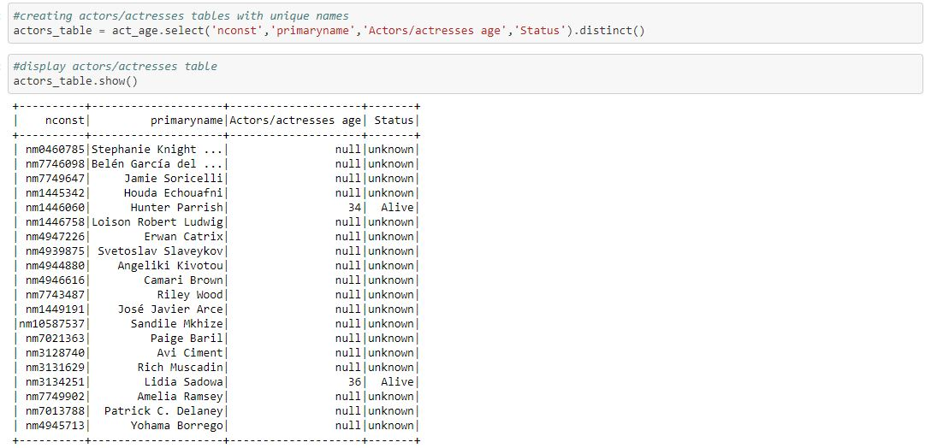
Requirement #1 Load
Used a tempview in order to display the desired columns(Name,Age,Status)

Slide 8
Requirement #2 Extract
Read in both “titles_basic” and “ratings” csv files using a S3 bucket
All column were included since we would decide use them as metadata in our final result.

Slide 9
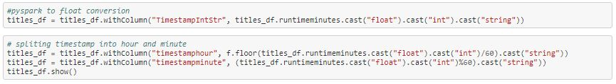
Requirement #2 Transform
Added a new column labeled “timestampStr” that took the string variable of the runtimeminutes column and converted it from string to a float,then to a int, and back to a string to remove the decimal point and zero. We then split the timeStamp value into “timestampminute” and “timestamphour” columns using modulus and division
Added a new column labeled “tsstring” which took the two timestamp variables as strings and added a semicolon between them.
Notes:
Talk about the errors tsstring caused(lack of 0 for single digits)

Slide 10
Requirement #2 Transform
Added a column labeled “date_time” which converted tsstring variable(string) into a timestamp variable.
Using the date_format function, we were able to remove the included date and seconds portions from the date_time column and save it in a new column labeled “runtime”.
Joined the table with the ratings table using the tconst as the shared column/key.
Notes:
Talk about the errors tsstring caused(lack of 0 for single digits)
Talk about the issue it caused(now there was a date…and seconds)

Slide 11
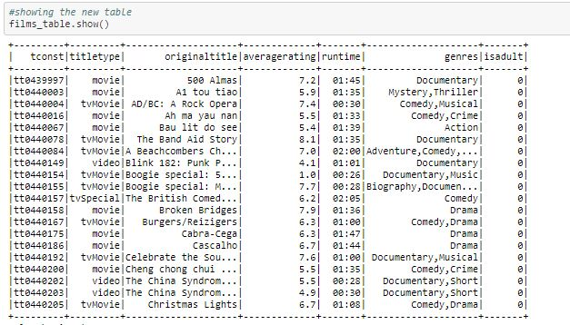
Requirement #2 Load
Using a tempview, we displayed the columns that we needed and the columns that we chose as metadata (tconst, titletype, originaltitle, averagerating, runtime, genres and isadult).
Notes:
Talk about the errors tsstring caused (lack of 0 for single digits)

Slide 12
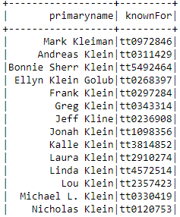
Requirement #3
Extract.
-Producers table containing only producer’s names and links to the film table.
titles_df = spark.read.csv(SparkFiles.get("titles_basic.csv"), sep=",", header=True)
rating_df = spark.read.csv(SparkFiles.get("ratings.csv"), sep=",", header=True)
Showed the data with “producer” names and “knownFor” columns. Using the “titles_csv” and “ratings_csv” files.

Slide 13
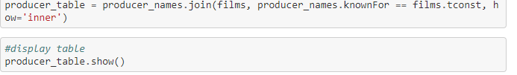
Transform.
Created producers table by joining producers_names and films table using tconst and knowFor values as links.

Slide 14
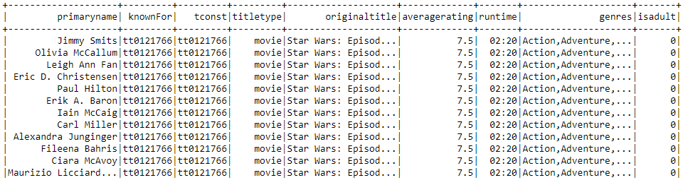
load
-Final loaded database table Linking
producer’s names to film table,
Which consisted of originaltitle, titletype,
Averageratings, runtime, genres, and is adult.

Slide 15
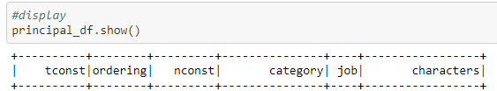
Requirement #4
Extract.
-A characters table with unique character names that links the actors and film tables together.
Selected csv file “FilteredPrincipals.csv”
-Selected columns

Slide 16
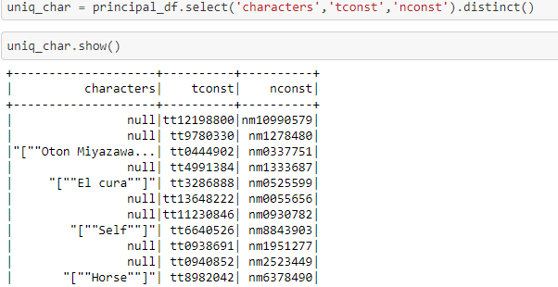
Transform.
-selecting only the needed columns.

Slide 17
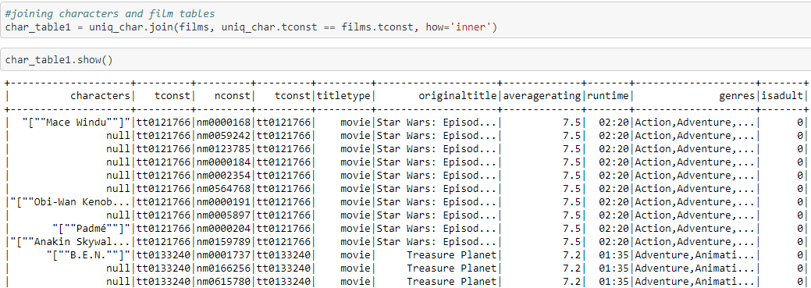
Transform continued.
-Joined characters and film tables only.

Slide 18
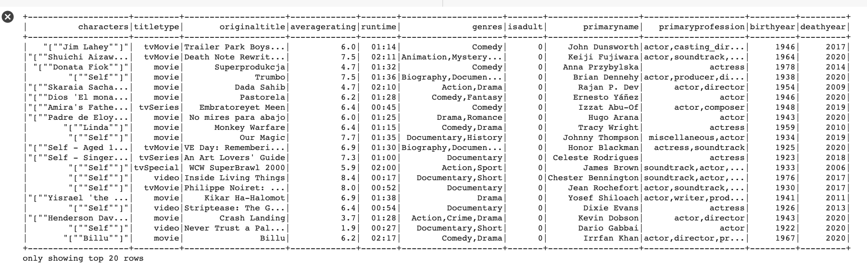
load.
-Completed database including character table joined with actors and film tables.
Dropped NA from character table:

Slide 19
Load continued.
-Final character table joined with film and actors/actresses tables using links.

Slide 20
conclusion.
More than expected
Importance of the task
Made database from datasets

Slide 21
Q & A

